Slide 1
Sign-Language Recognition Using Machine Learning
G kiran kumar (318126510139)
E V M Prateek (318126510138)
Azharuddin (318126510174)
Guided By
Dr. V Usha Bala
Internal review

Slide 2
What is sign language?
Sign language is a way of communicating using hand gestures and movements, body language and facial expressions, instead of spoken words.
There are different sign languages
Indian sign language
American sign language
British sign language
The sign language we are Recognising is INDIAN Sign Language

Slide 3

Problem Statement
To Identify the signs and gestures in Indian sign language and convert them into English.
?
?
?

Slide 4
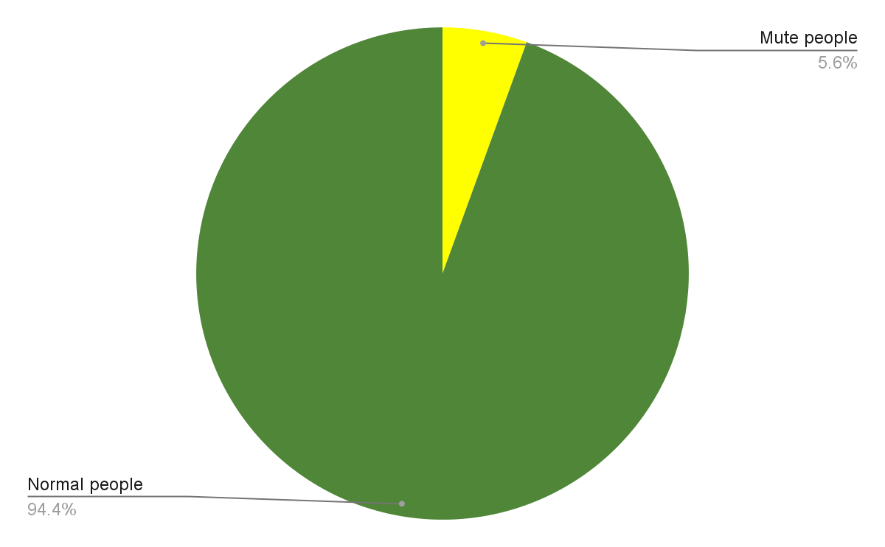

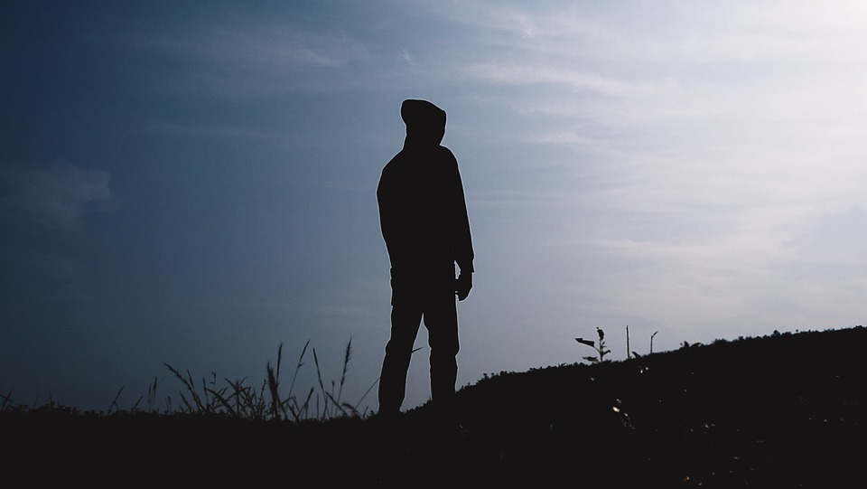
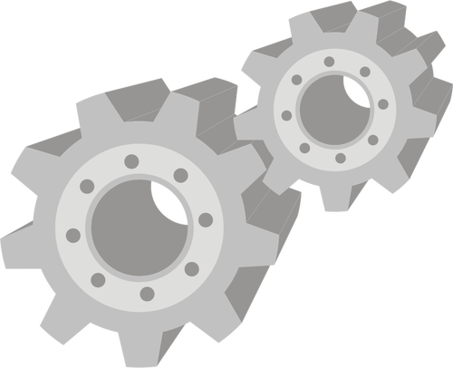
Scope of project
Translator
Sign language
Verbal Communication

Slide 5
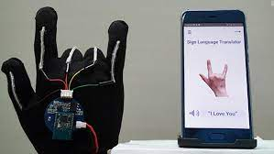
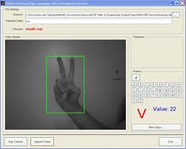
Existing System
There are a few sign language translation systems
Sensor Gloves
Accurate
Easy to use
Costly
Algorithms to recognise signs
Cost effective
Uses color gloves sometimes to increase Accuracy
Less accuracy for multi handed signs

Slide 6
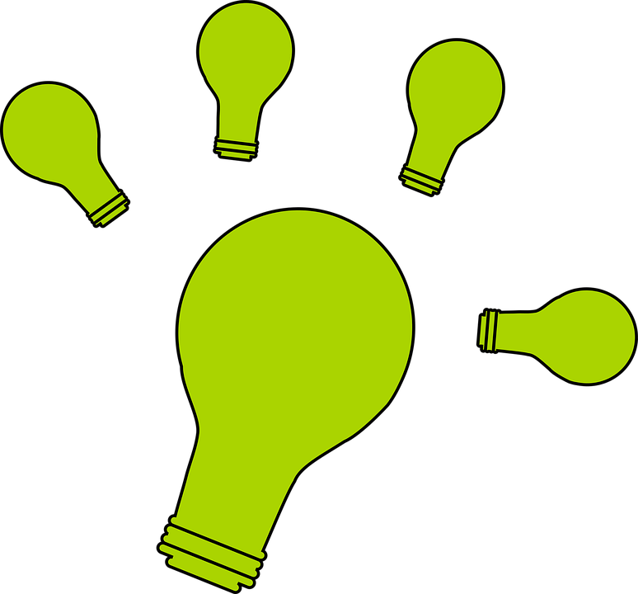
Proposed System
We propose to use Machine learning algorithms to recognise the Gestures and signs in Indian sign language.
We train the Machine learning model with videos containing signs and gestures in indian sign language.
We will send the words identified to a sentence generator algorithm to make a proper english sentence with the generated words.
Finally the generated output will be shown on screen and played out-loud using the device speaker.

Slide 7

Abstract
While there is no problem among them to communicate smoothly using this language the problem comes when they try to communicate with people who do not know sign language. We suggest a solution to this problem using ML based translator that can identify Indian sign language and translate to English.

Slide 8
Architecture
Step 1: To extract the frames from the video captured.
Step 2: Identify the gestures in the video.
Step 3: Send the generated words to Sentence generator.
Step 4: Generate a proper English sentence.
Step 5: Display the sentence Tell the sentence out loud using device audio

Slide 9
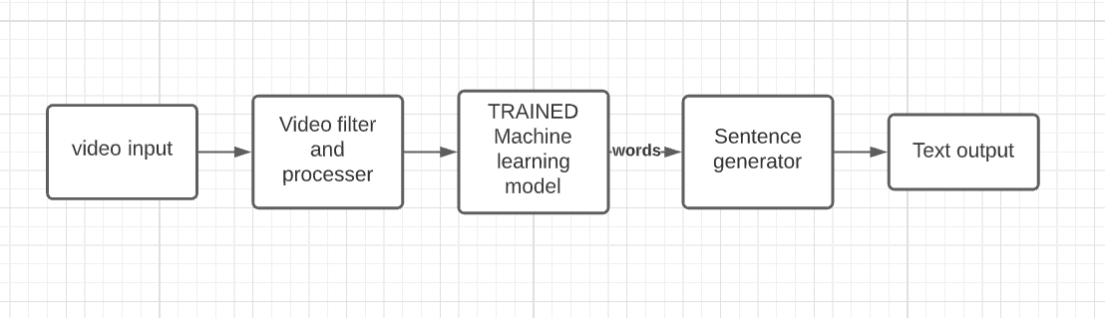

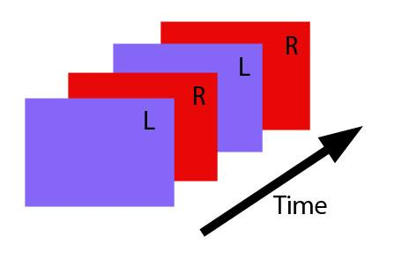
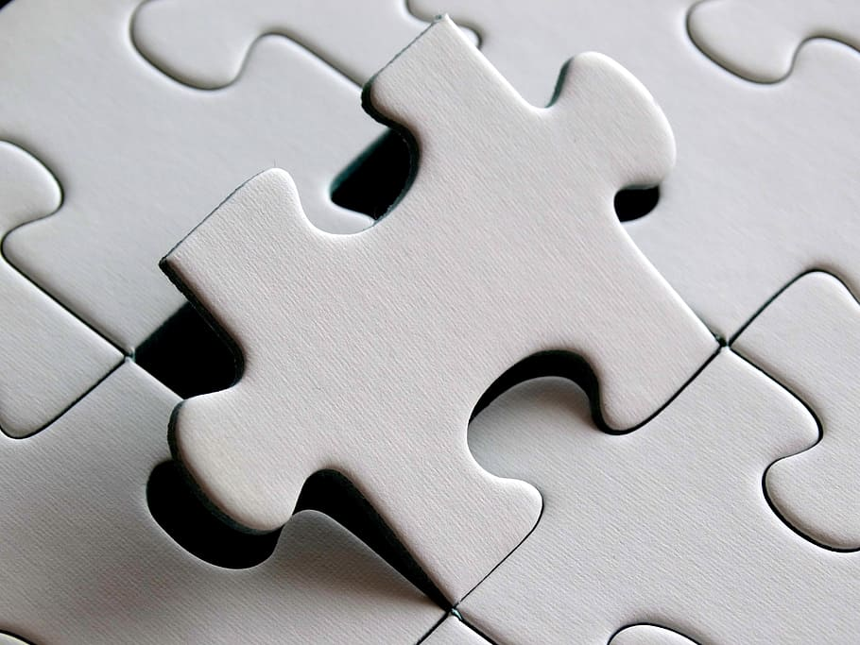
Architecture diagram
I am Kiran

Slide 10
Module division
Face gesture
Recognition Model
VIDEO PROCESSOR
Extracts face, hand
Text output
Gui and Speaker output
INPUT
Video or
Image
I am Kiran
Hand gesture recognition Model

Slide 11
PHASE 01
Alphabet Recognition

Slide 12
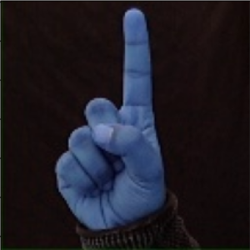
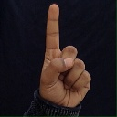
Dataset Acquisition and Modifications
Dataset is taken from Kaggle (Link)
Transformed dataset to account both right hand and left hand users.

Slide 13
Code Analysis For phase - 1
Training phase (IMAGE dataset for signs/Alphabets)
Train the CNN algorithm using Images of signs in Indian Sign language
TRAINED MODEL
IMAGES
CNN MODEL

Slide 14
Recognition Phase
Use the trained model to recognised Alphabets and Digits.
Recognise the gesture from the image.
TRAINED CNN MODEL
RECOGNISED GESTURES
IMAGES

Slide 15
Convolution Neural Networks
Training with image data and Extracting Features
Each sign having a certain interval and Automatically detected from input video stream
OUTPUT
Recognised Gesture
Input
Trained model
Image data
Trained using image Dataset
Alphabet based on training data

Slide 16
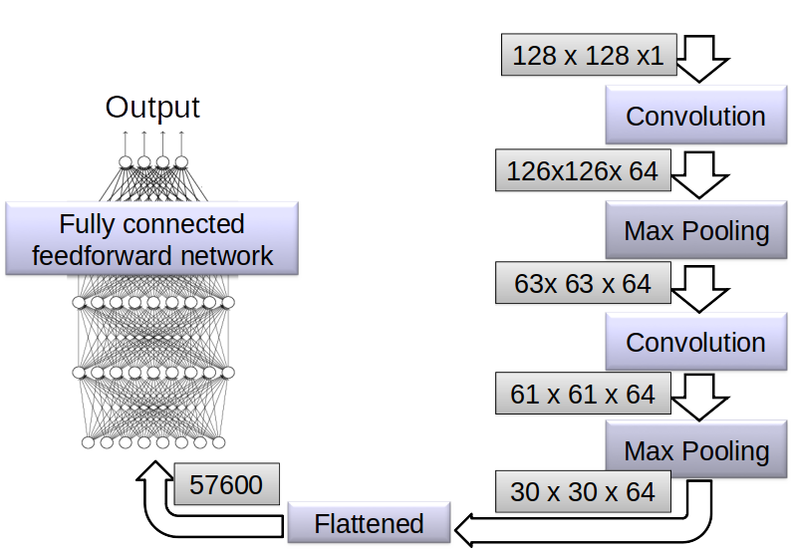
Convolution Neural Networks Architecture
OUTPUT (DENSE 35)
DENSE 512

Slide 17
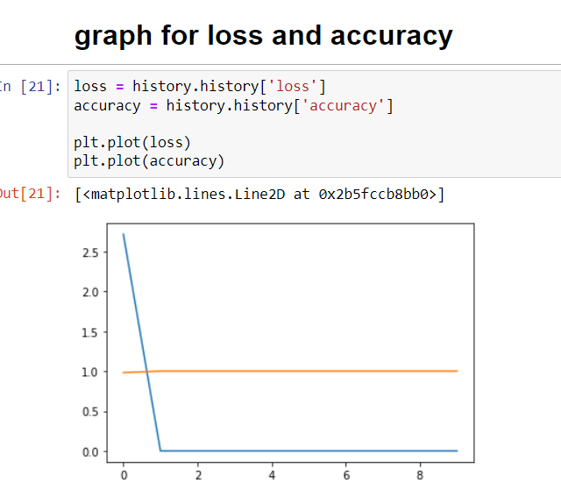
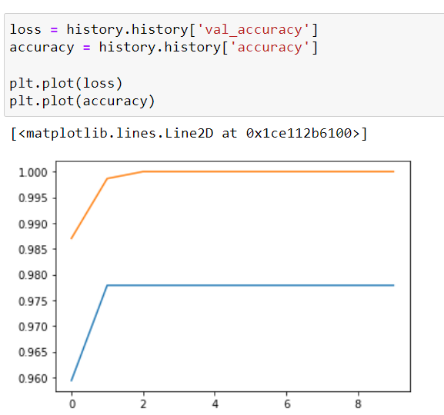
Accuracy Graphs

Slide 18
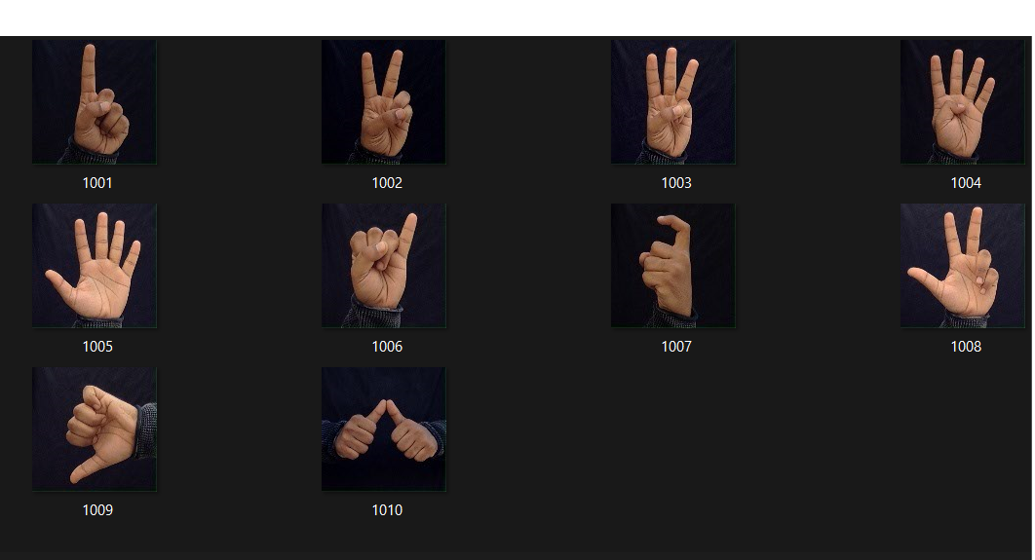
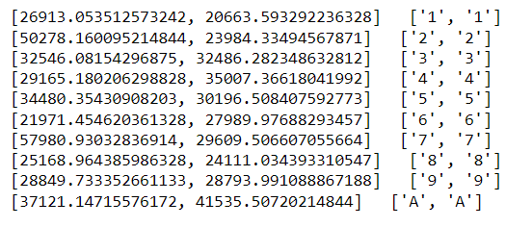
Sample Output
HI

Slide 19
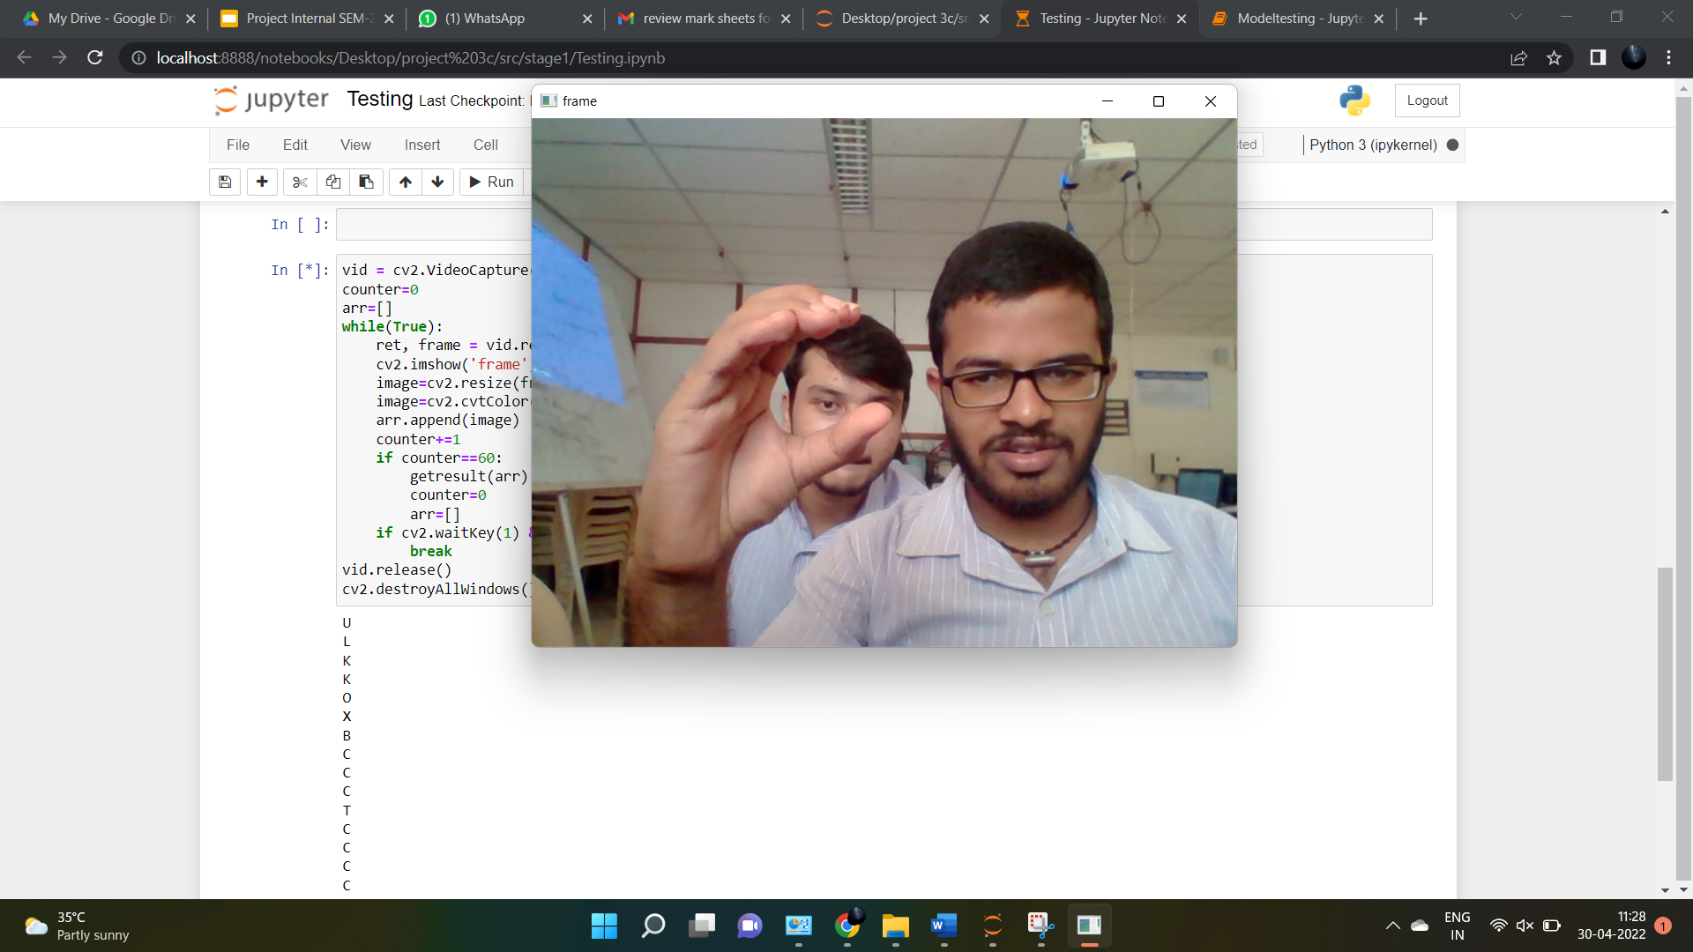
HI

Slide 20
PHASE 02
SIGN Recognition

Slide 21
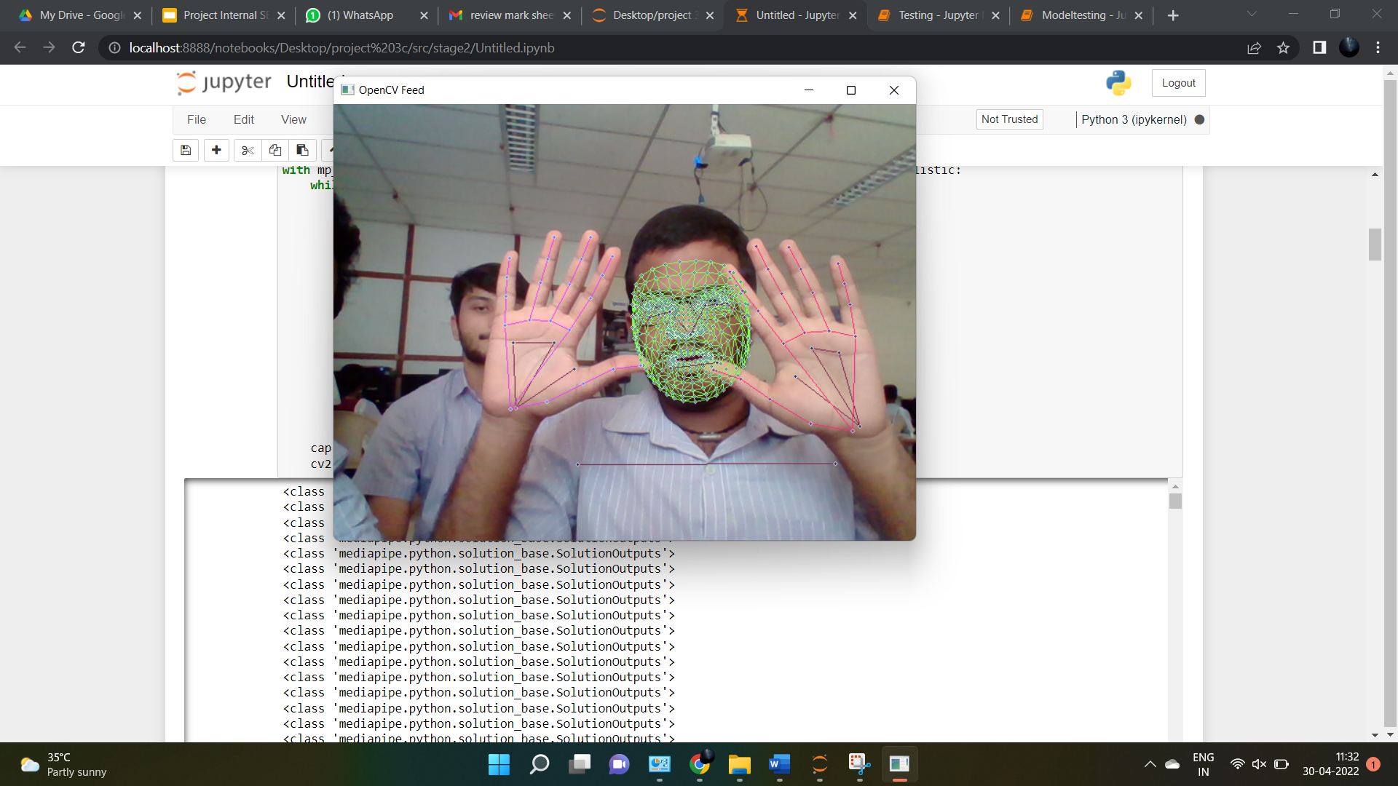
Dataset Acquisition and Modifications
Dataset is Custom made by our team members.
Transformed dataset with Mideapipe to extract anchor points.

Slide 22
Code Analysis For phase - 2
Training phase (VIDEO dataset for gestures/words)
Train the LSTM algorithm using Images of signs in Indian Sign language
TRAINED MODEL
VIDEOS
LSTM MODEL

Slide 23
Recognition Phase
Use the trained model to recognise gesture in the video
Recognise the gesture from the video frame
TRAINED LSTM MODEL
RECOGNISED GESTURES
LIVE VIDEO

Slide 24
LSTM
Training with image data and Extracting Features
Each sign having a certain interval and Automatically detected from input video stream
OUTPUT
Recognised Gesture
Input
Trained model
Image data
Trained using image Dataset
Alphabet based on training data

Slide 25
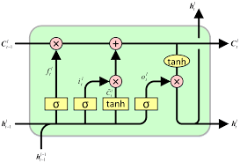
LSTM Architecture
DENSE3
LSTM 64
LSTM 64
DENSE 64
DENSE 32
LSTM 128
LSTM 64

Slide 26
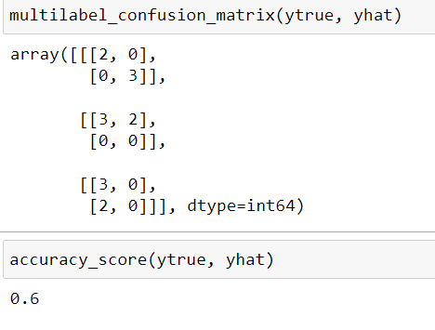
Accuracy Measure

Slide 27
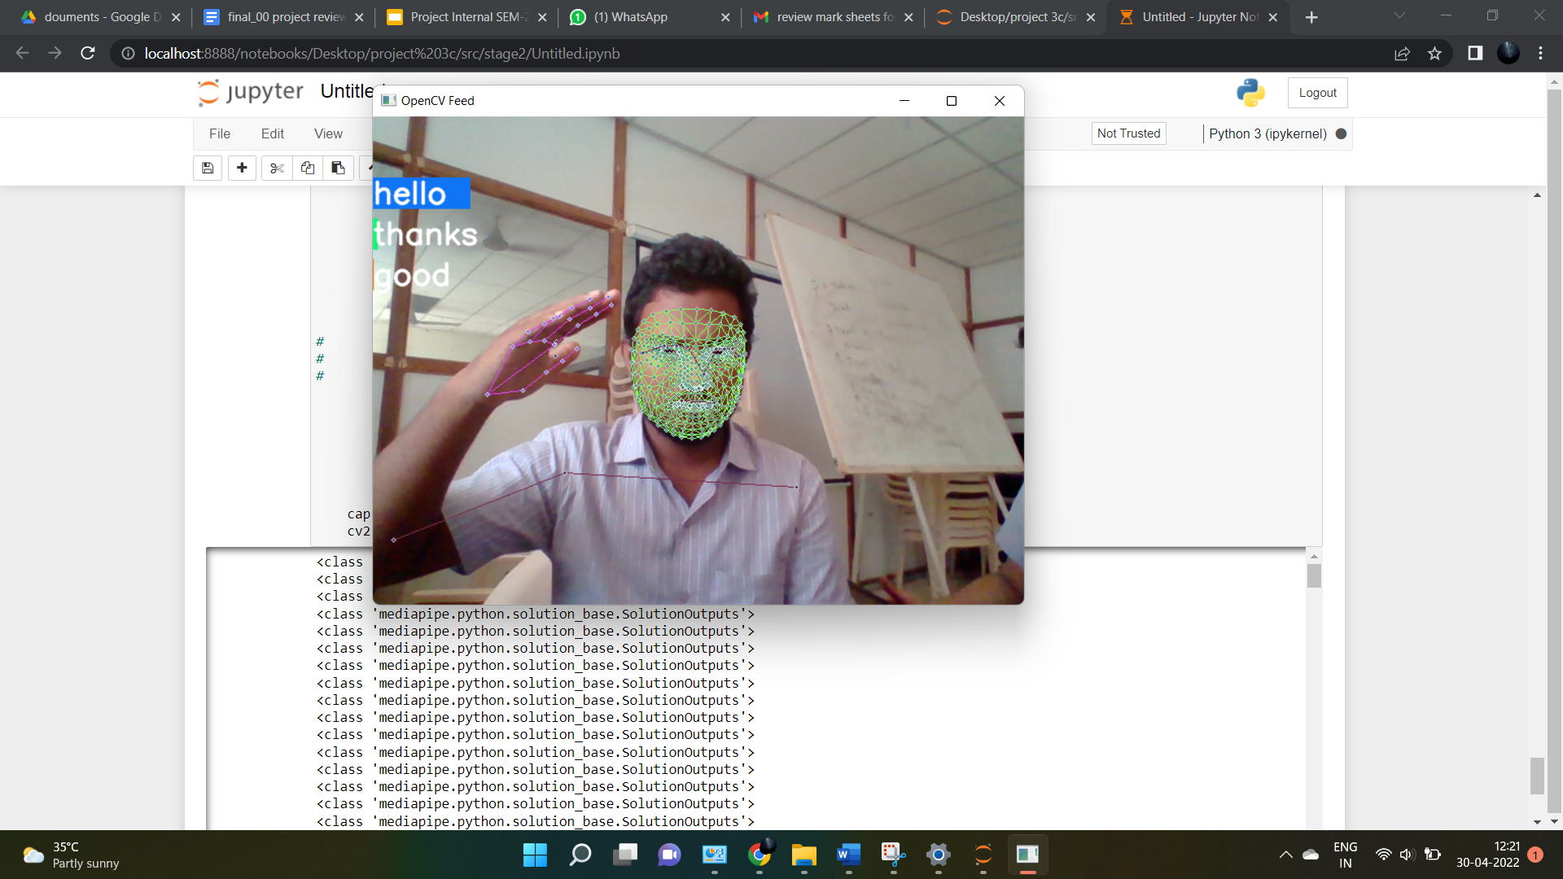
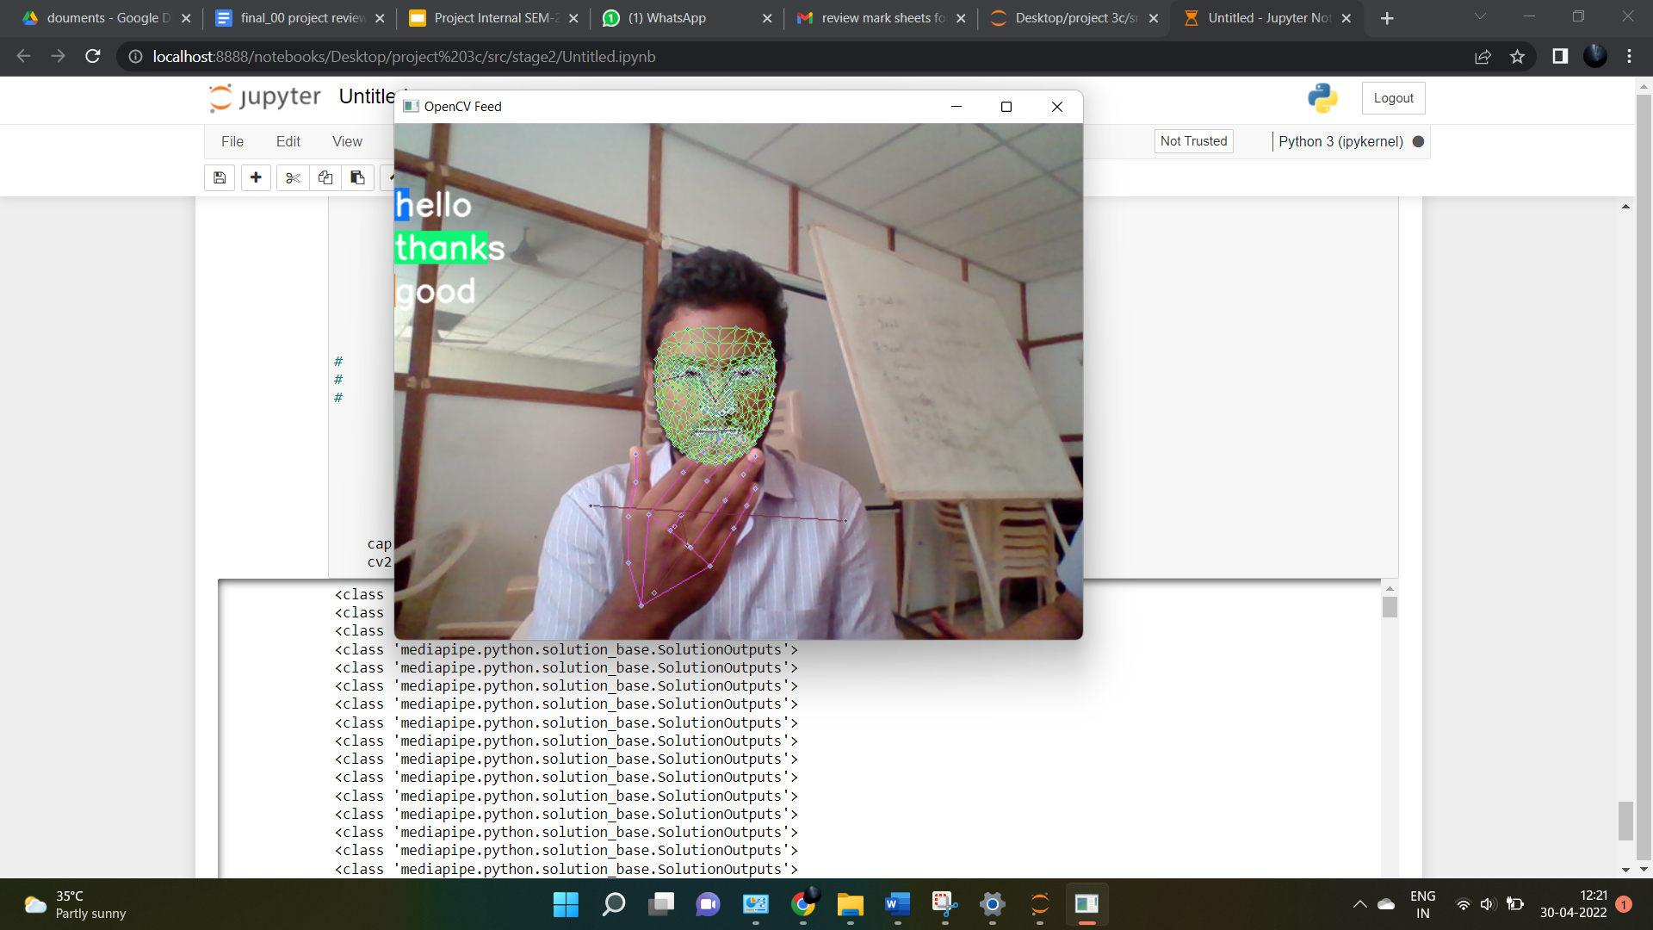
Sample Output
Video input
Processed
video
HI

Slide 28
PHASE 03
Sign Recognition with face emotion recognition

Slide 29
Dataset Acquisition and Modifications
Dataset is taken from Kaggle (Link)
Transformed dataset to account both right hand and left hand users.

Slide 30
Accuracy Graphs

Slide 31
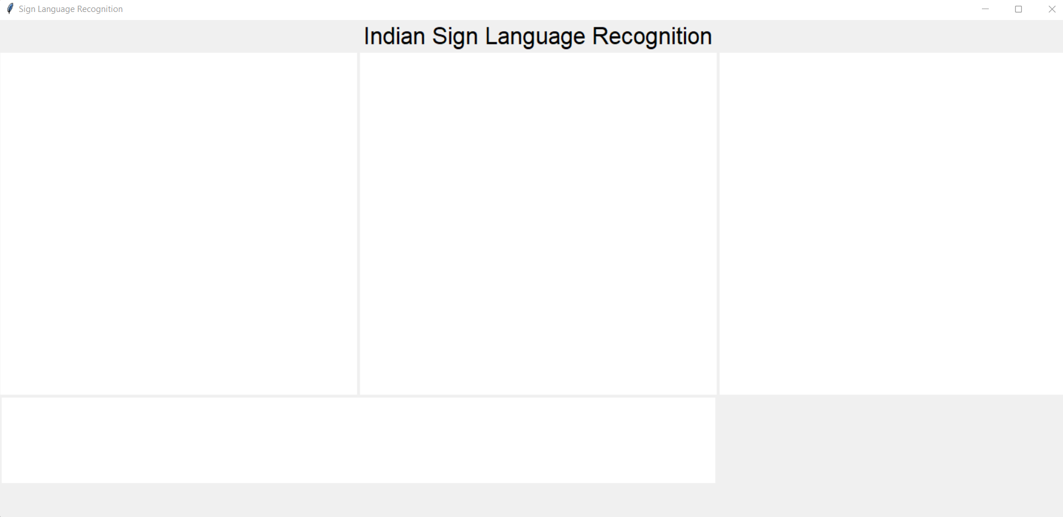
Sample Output
Video input
Processed
video
HI

Slide 32

Technologies used
Tensorflow
To train the CNN model using the inbuilt Modules in tensorflow
Tkinter
To make a stand-alone applications with various elements available in Tkinter
Pickle
To convert Images to Matrices and saving them for training and testing on future

Slide 33
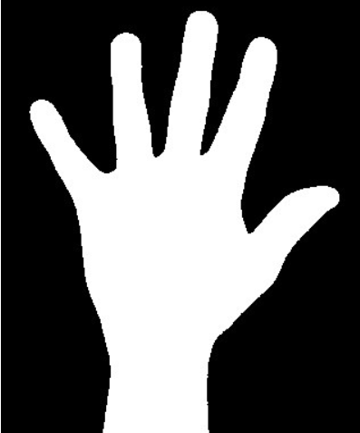
Existing problem and our solutions to the problem
Existing problem
We’ve found that the hands with black background are accurately recognised, where as hands with colored background are not being recognised.
Suggested solution
The Solution we came up with is to find outline of the hand and to differentiate the hand in the image from the background.

Slide 34
Constraints
Other objects apart from the signs are not recognised
For Noisy images output is not accurate

Slide 35
Moving Forward
Going to implement the potential solutions.
The Video Dataset is chosen in the further phase when accuracy result is satisfactory.
Using 13 Classifications of video dataset which include various gestures.
Frames from the video is extracted and are recognised by the trained model that follows similar recognition to the phase 1.

Slide 36
PAPER PUBLICATION
Going to implement the potential solutions and see if the accuracy improves.
The Video Dataset is chosen in the further phase when accuracy result is satisfactory.
Using 13 Classifications of video dataset which include various gestures.
Frames from the video is extracted and are recognised by the trained model that follows similar recognition to the phase 1.

Slide 37
References
Research Papers
Accuracy analysis paper
Project Idea paper
Implementation inspiration paper
https://drive.google.com/file/d/1gOO20k-eyH7GtNm1PfjSQ5wXD9w6_5kD/view?usp=sharing
https://drive.google.com/file/d/1EIQ-XWRxuzSEGoclHD1yBYRLzSeUpB18/view?usp=sharing
https://drive.google.com/file/d/14sdlBv7UYz2qbprNgnMNL1QyvZBZFyXU/view?usp=sharing

Slide 38
References
Implementation references
Tensorflow Reference videos
Tkinter for GUI videos
Pickle videos
Tensorflow Documentation
Tkinter Documentation
Pickle Documentation

Slide 39
References
Documentation , words selected
project details
Project documentation
Official Sign translation and dictionary
https://indiansignlanguage.org/
http://www.islrtc.nic.in/

Slide 40
Thank you for your time

